Slide 1
Consistency and Replication
Chapter 7

Slide 2
Introduction(7.1)
1. Reasons for Replication:
Data are generally replicated to enhance reliability or improve performance in distributed system or parallel computers system.
How to keep replicas consistent is one of the major problems. when one copy is updated, we need to ensure that the other copies are updated as well.
1) Gain in performance； 2) Cost of increased bandwidth for maintaining replication；

Slide 3
Introduction(7.1)
2. Object Replication
1) A distributed remote object is shared by multiple clients-------how to protect the object against simultaneous access by multiple clients.
2) A distributed remote object is replicated at different node-------how to ensure that concurrent invocations are performed in the correct order at each of the replicas.
Notes:
复制及一致性特例
数据-对象（封装了数据及相关操作）
1.互斥访问（操作系统）object内部包含数据
2.多副本间一致性（本章内容）

Slide 4
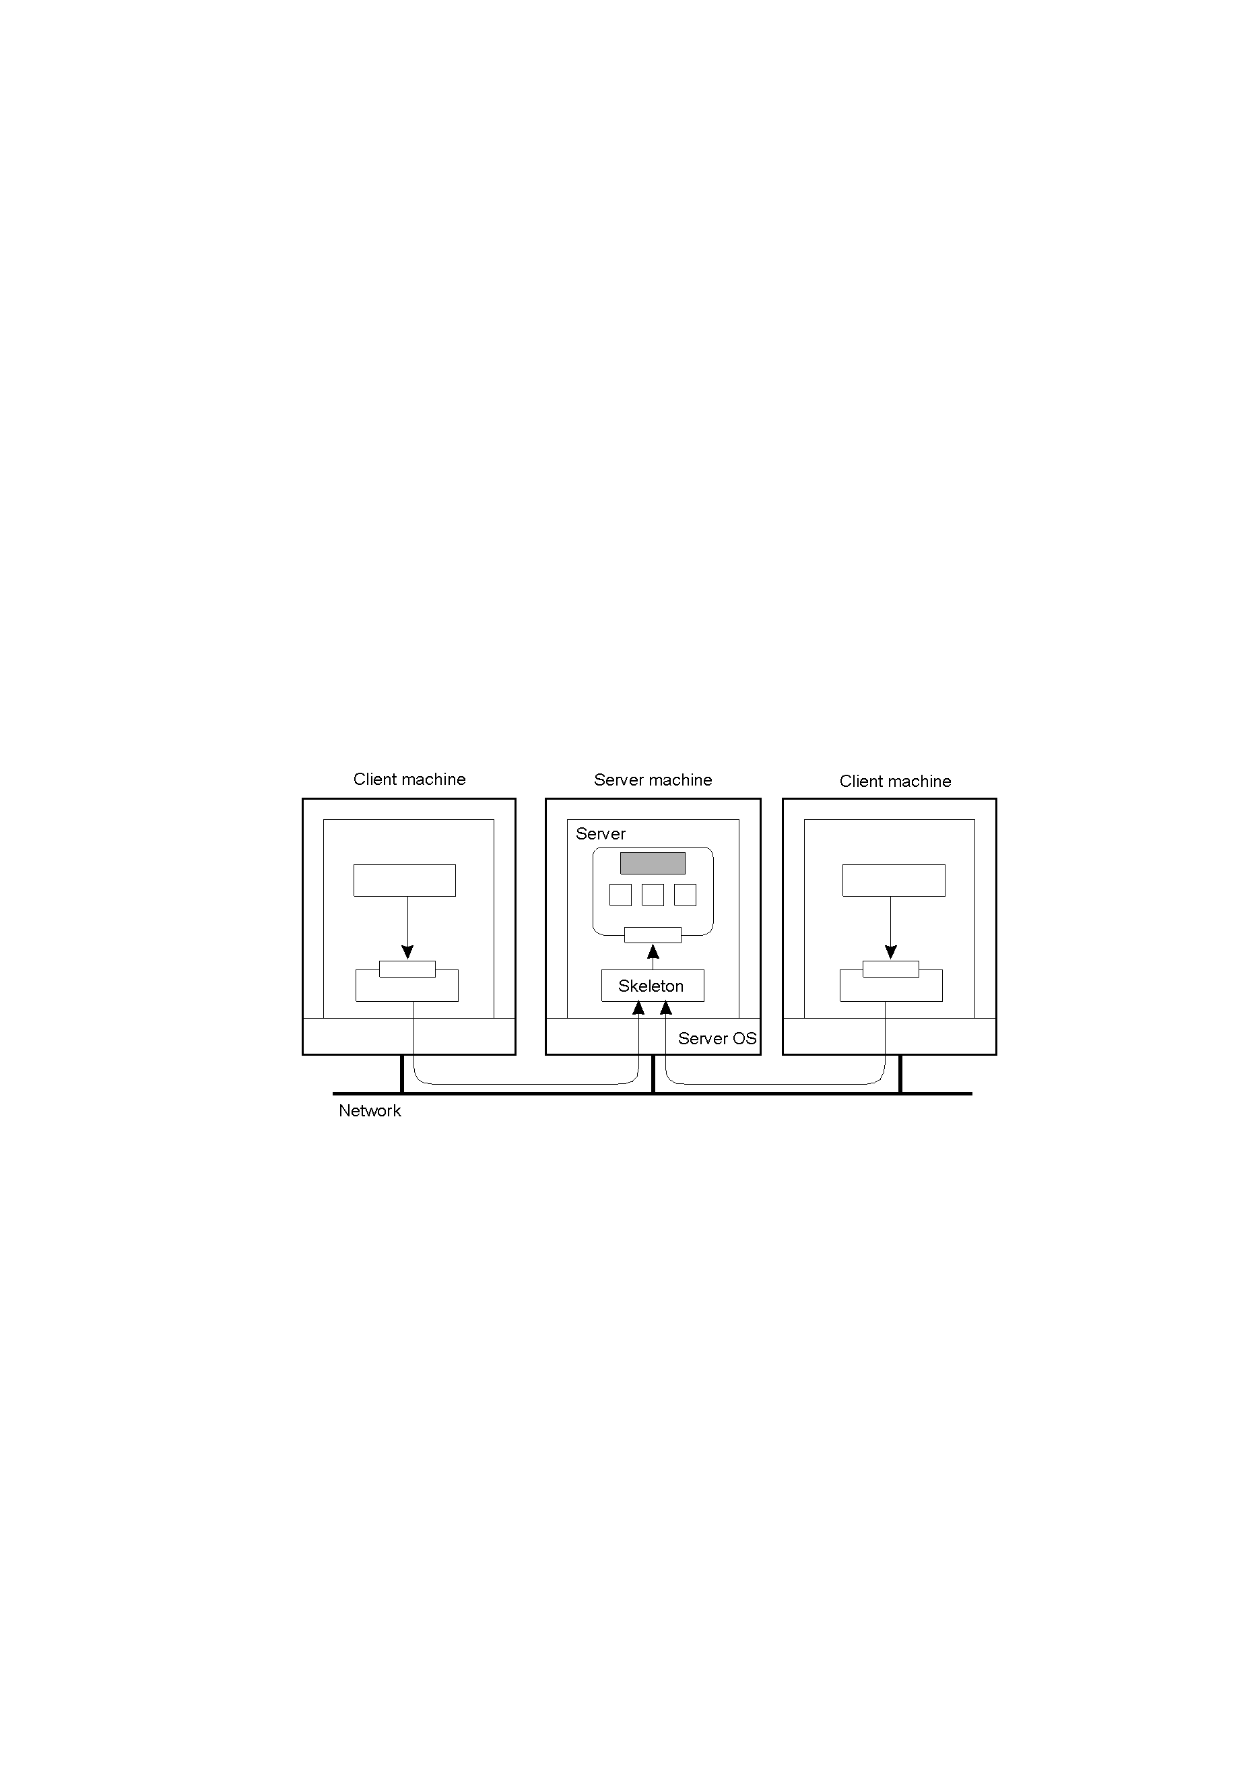
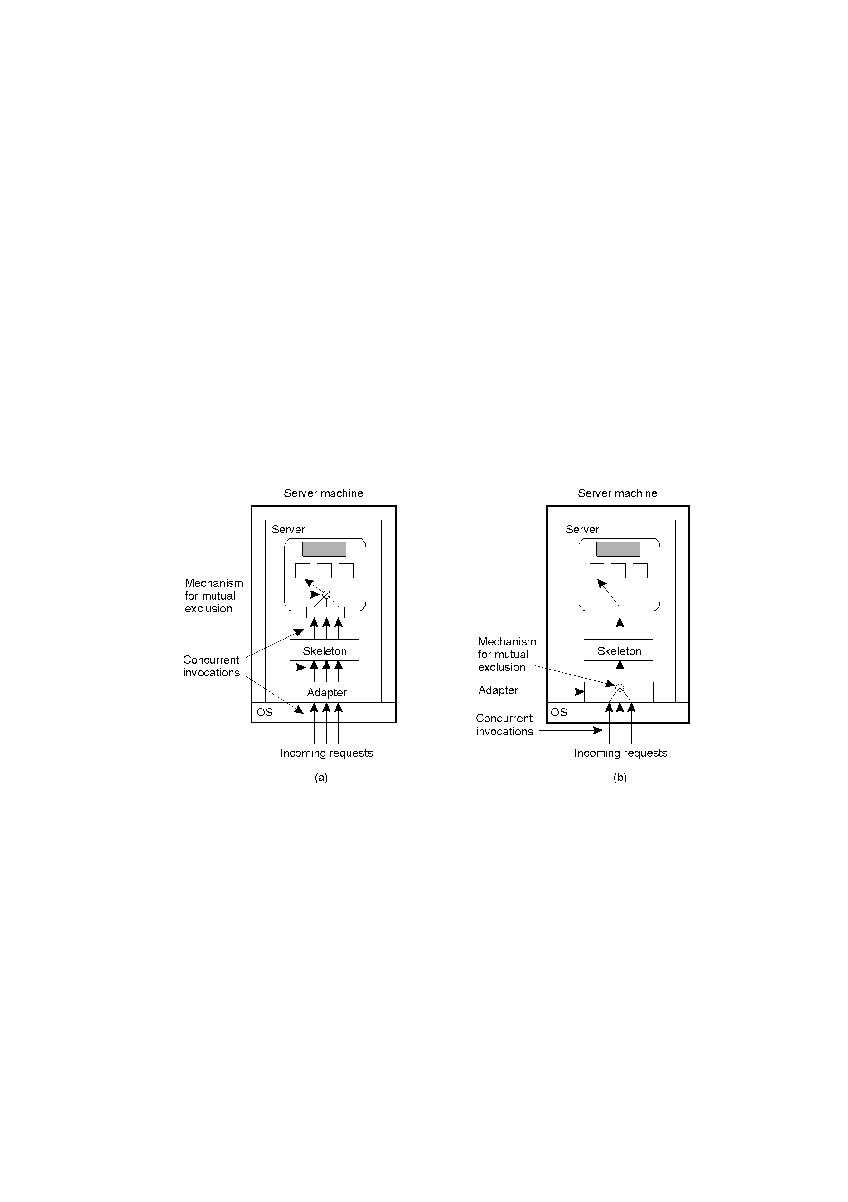
Object shared
Organization of a distributed remote object shared by two different clients.
a)A remote object capable of handling concurrent invocations on its own
b)A remote object for which an object adapter is required to handle concurrent invocations

Slide 5
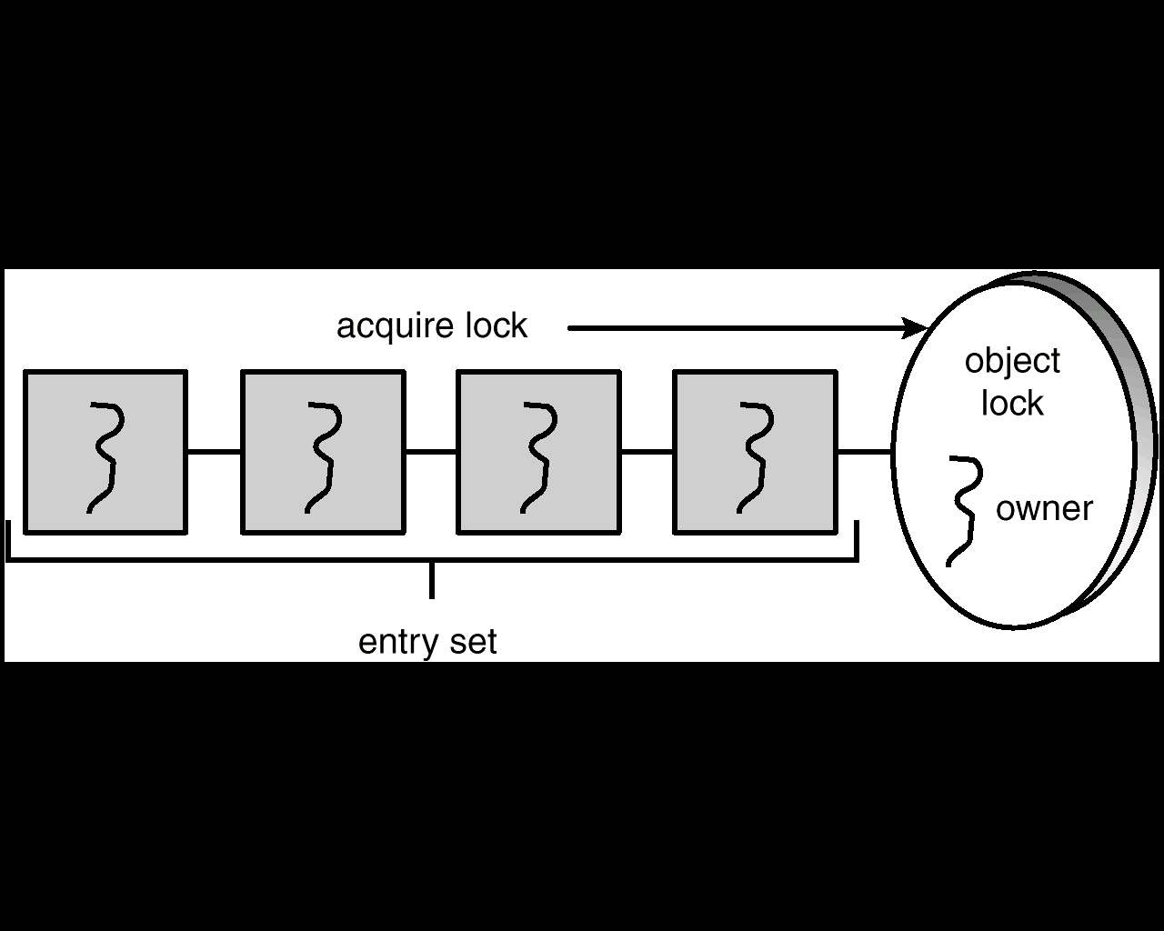
Object shared
Fig(a): For example, java object----which can be constructed as a monitor by declaring the object’s method to be synchronized.
public synchronized void enter(Object item) {
while (count == BUFFER_SIZE)
Thread.yield();
++count;
buffer[in] = item;
in = (in + 1) % BUFFER_SIZE;
}
Notes:
对象：数据，操作
实现操作对数据的互斥访问；
通过锁的方式；
向程序员透明；

Slide 6
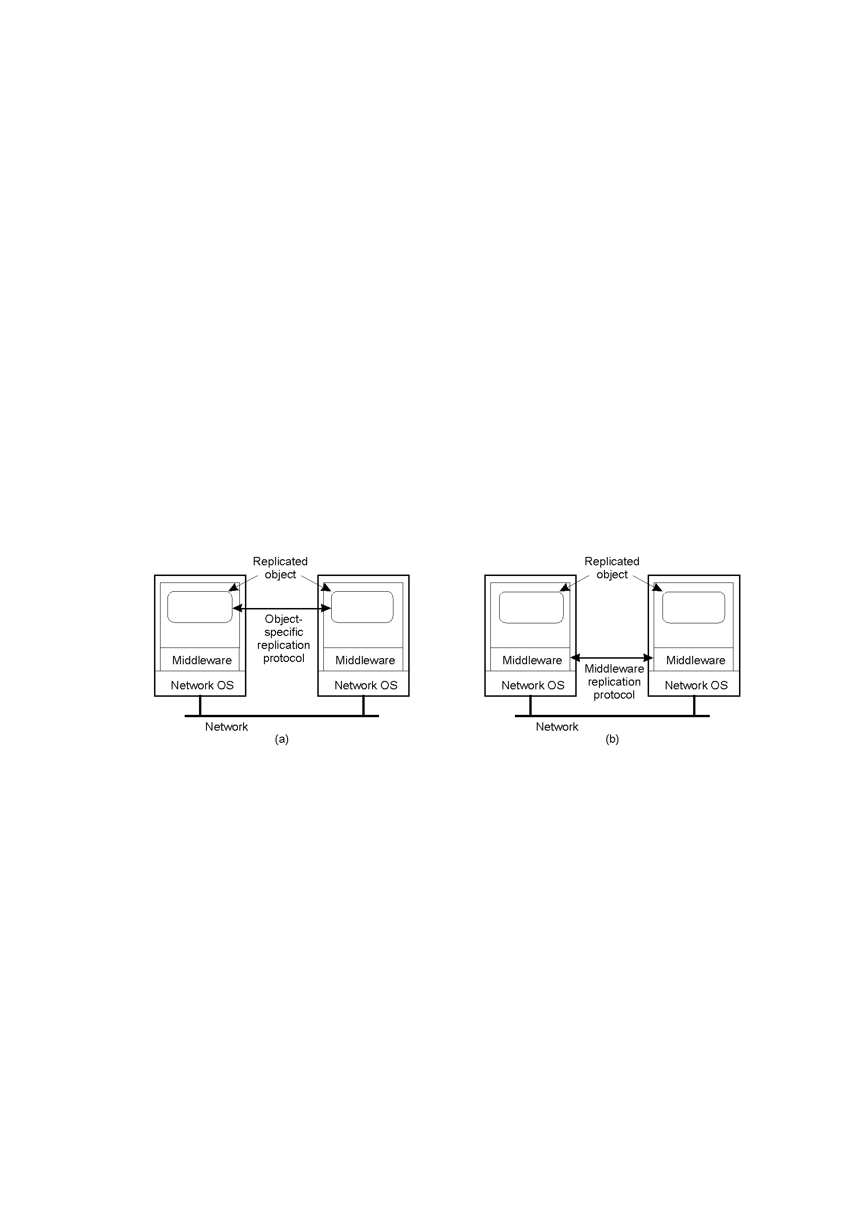
Object Replication
a) A distributed system for replication-aware distributed objects.（SOS，Globe etc.）
b) A distributed system responsible for replica management (CORBA etc.)
实现机理与一致性模型?
Notes:
并发调用，单object互斥；多个复制object一致性（调用后数据不一致）；
和数据一致性类似；
需要专门的一致性协议；

Slide 7
Object Replication
3. Replication as Scaling Technique
Placing copies of data and objects close to the processes using them can improve performance through reduction of access time, and thus solve scalability problems. Replication and caching for performance are widely applied as scaling techniques.
Dilemma problem
Scalability problem can be alleviated by applying replication and caching, leading to improved performance.
To keep all copies consistent generally requires global synchronization, which is inherently costly in terms of performance.
Notes:
一致性；

Slide 8
TWO CONSISTENCY MODELS
1. DATA-CENTRIC CONSISTENCY MODELS.
2. CLIENT-CENTRIC CONSISTENCY MODELS

Slide 9
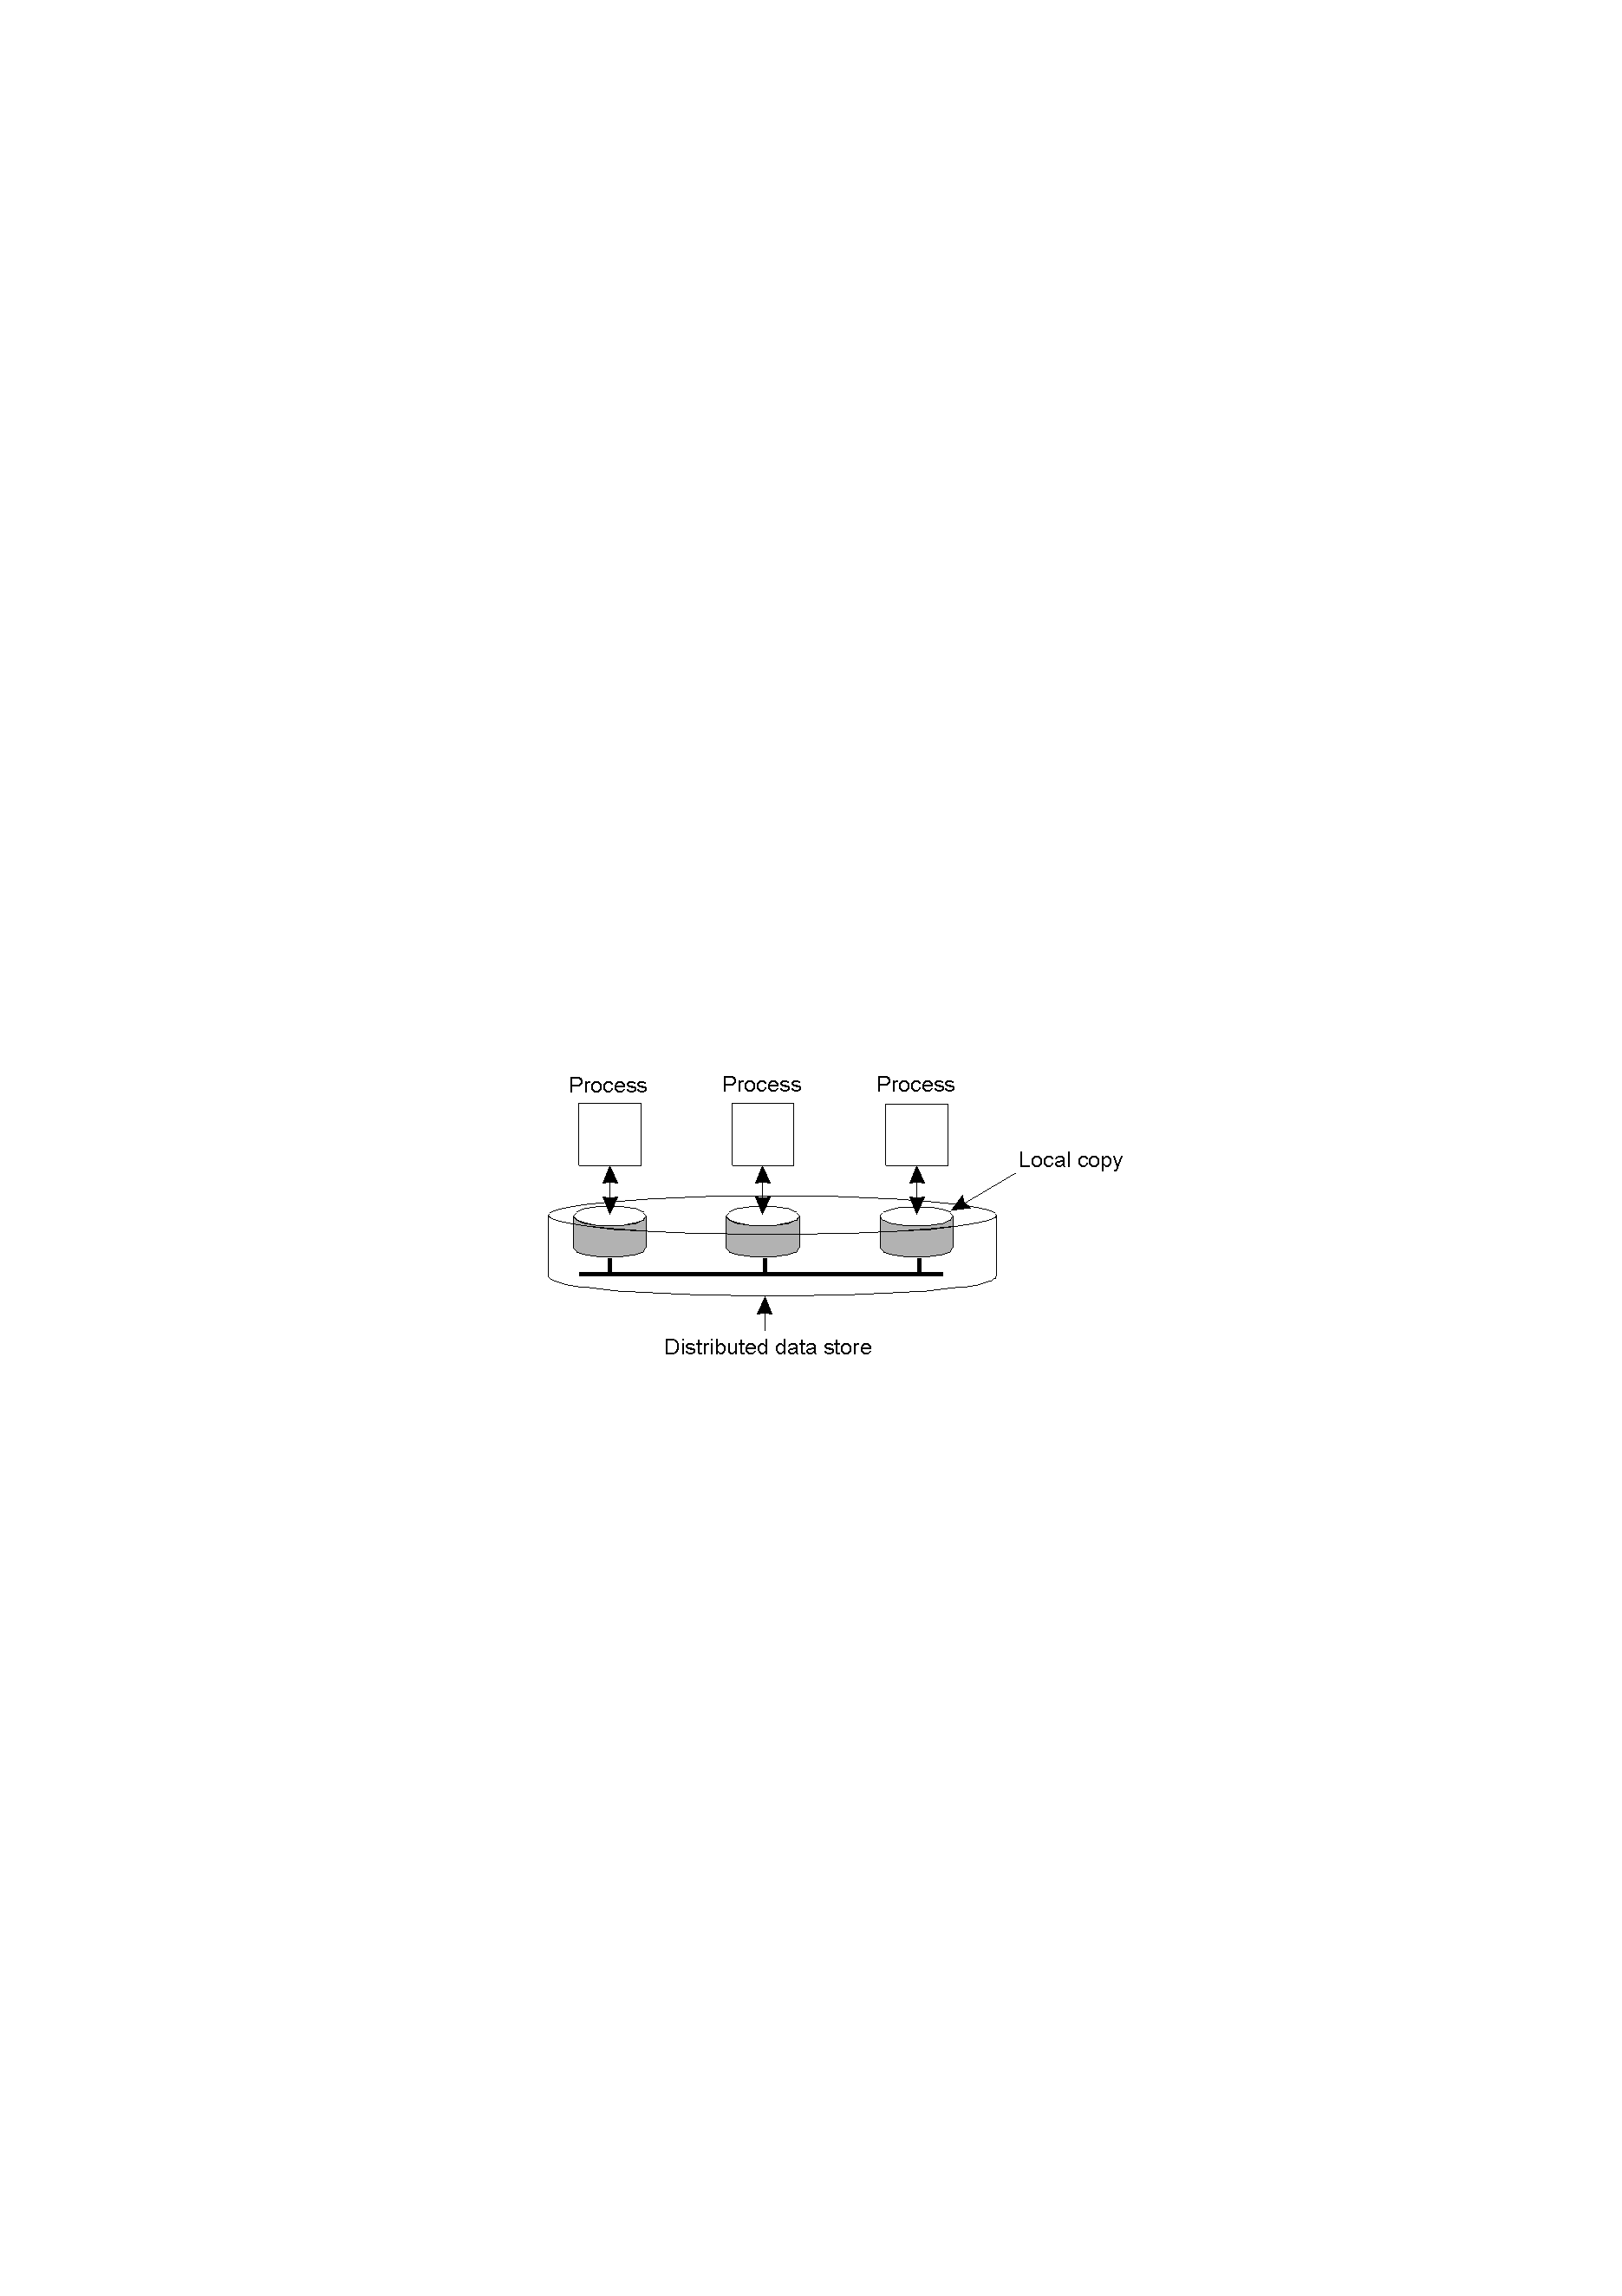
DATA-CENTRIC CONSISTENCY MODELS
A data store may be physically distributed across multiple machines: shared memory, shared database, or a file system(distributed) .
A data operation is classified as: write operation; read operation;
each process that can access data from the store is assumed to have a local(or nearby) copy available of the entire store. Write operations are propagated to the other copies.
The general organization of a logical data store, physically distributed and replicated across multiple processes.
Notes:
定义：分布式存储，读写

Slide 10
Data-Centric Consistency Models
A consistency model is essentially a contract between process (read/write) and the data store. It says that if processes agree to obey certain rules, the store promises to work correctly.
In the absence of a global clock, it is difficult to define precisely which write operation is the last one, so we need to provide definitions, leading to a range of consistency models. Each model effectively restricts（限定） the values that a read operation on a data item can return.
Notes:
promises to work correctly：values that a read operation on a data item can return
严格一致性：严格排序，针对一个读操作，返回最近一次写操作后的结果
针对严格一致性放松要求，产生一系列一致性模型

Slide 11
Strict Consistency(7.2.1)
strict consistency:
Any read on a data item x returns a value corresponding to the result of the most recent write on x.
例：单一处理机遵守严格一致性，有如下程序：
A=1；A=2；PRINT（A）；
打印1或2以外的任何值是编程者无法理解的。
Notes:
和单机比的区别：同读写同一台机器，有全局时钟
同读写在不同机器上机器，没有全局时钟

Slide 12
Strict Consistency(7.2.1)
假设在DCS中有如下情形：先读后写。
Node A Node B
P1 x
…
read(B:x at t1) P2
… t2-t1=1ns
Write(B:x at t2)
严格一致性: A应该读出写之前的x值。假设机器间距离3米，从A到B传送读操作并使之先于B的写操作，则信号必须以十倍光速传递，与相对论矛盾. 1ns(纳秒)=10⁻⁹秒。
Notes:
无法保障遵守绝对全局时间（在有全局时钟的前提下）；

Slide 13

Strict Consistency(7.2.1)
Behavior of two processes, operating on the same data item.
(a) A strictly consistent store； (b) A store that is not strictly consistent；
严格一致性存储器：写操作在任一时刻对所有进程可见，后读出的是新更改值。反之，无论后面的写操作有多快，前面读操作的值仍是原来的值。
系统维护一个绝对全局时间。严格一致性是理想的编程模式，在分布式系统中，这几乎不可能实现。
Notes:
两个进程，两个数据备份，时间线
1.严格一致性存储器（分布式环境下难以实现：有网络延迟）

Slide 14
Linearizability and Sequential Consistency (7.2.2)
Sequential consistent(顺序一致性条件，Lamport 1979) ：
The result of any execution is the same as if the (read and write)operation by all processes on the data store were executed in some sequential order and the operations of each individual process appear in this sequence in the order specified by its program.
存储器上的数据给所有进程所呈现出来的状态（执行结果）要遵循某一顺序（不同机器上并发运行的进程，任何有效的交错是可以接受的，但所有进程必须遵守同一访问顺序）。
Notes:
不同机器，不同进程，各自独立执行（并发执行）
存储器上的数据给所有进程所呈现出来的状态（执行结果）要遵循某一顺序，顺序；
（）
举例：

Slide 15

Linearizability and Sequential Consistency (7.2.2)
A sequentially consistent data store.
A data store that is not sequentially consistent.
不保证读返回值是1ns/1ms/1分钟以前另一进程写入的。只保证所有进程以相同的顺序看见存储器的访问(图a)，如果缺少明确的同步操作，则结果是不确定的。
Notes:
举例：通信延迟
存储器：多机多副本（分布式系统）
单机但副本（单机操作系统）

Slide 16
Linearizability and Sequential Consistency (2)
Process P1 | Process P2 | Process P3
x = 1; print ( y, z); | y = 1; print (x, z); | z = 1; print (x, y);
6个语句共有720(6！)种可能的执行顺序，但是，只有90个是有效的。
注：x=1开始的顺序有120(5！)种,其中只有1/4（y=1/z=1在print()前,各1/2）即30个是有效的。另外，分别是以y=1和z=1开头的各30个。
Three concurrently executing processes.
Notes:
=写
print读
数据（xyz）备份存储3份
剩下360个，print开头120，无效；

Slide 17
Linearizability and Sequential Consistency (3)
x = 1; print ((y, z); y = 1; print (x, z); z = 1; print (x, y); Prints: 001011 Signature: 001011 (a) | x = 1; y = 1; print (x,z); print(y, z); z = 1; print (x, y); Prints: 101011 Signature: 101011 (b) | y = 1; z = 1; print (x, y); print (x, z); x = 1; print (y, z); Prints: 010111 Signature: 010111 (c) | y = 1; x = 1; z = 1; print (x, z); print (y, z); print (x, y); Prints: 111111 Signature: 111111 (d)
Four valid execution sequences for the processes of the previous slide. The vertical axis is time.
Notes:
和严格一致性的区别；

Slide 18
Linearizability and Sequential Consistency (3)
Linearizability consistency:
满足顺序一致性约束且同时满足时间戳的顺序（比顺序一致性强）
The result of any execution is the same as if the (read and write)operation by all processes on the data store were executed in some sequential order and the operations of each individual process appear in this sequence in the order specified by its program. In addition, if ts_{OP1}(x) < ts_{OP2}(y), then operation OP1(x) should precede OP2(y) in this sequence.
Let ts_{OP1}(x) denote the timestamp assigned to operation OP that is performed on data item x；
Notes:
粗粒度时间戳排序，不能反映出精确的实际时间
可实现的最严格一致性；

Slide 19
Linearizability and Sequential Consistency (4)
A common approach to formally express sequential consistency is as follows (Ahamad et al., 1992; Mizunoet al., 1995).另一种表示。
Each process Pi has an associated execution Ei, which is a sequence of read and write operations by process Pi performed on a data store S. This sequence adheres to the program order associated with Pi. For example.
E1:W1(x)a;
E2:W2(x)b;
E3:R3(x)b,R3(x)a;
E4:R4(x)b,R4(x)a;
Then H= W1(x)b,R3(x)b, R4(x)b ,W2(x)a,R3(x)a,R4(x)a

Slide 20
Causal Consistency (7.2.3)
Necessary condition:
Writes that are potentially casually related must be seen by all processes in the same order.（因果相关的写入）
Concurrent writes may be seen in a different order on different machines.
所有进程仅看到满足因果关系一致性模型的写操作结果。

Slide 21

Causal Consistency (2)
无因果关系写
A来自P1，B是因果关系写
This sequence is allowed with a causally-consistent store, but not with sequentially or strictly consistent store.(W2(x)b and W1(x)c are concurrent).可以是不同进程的因果顺序.比如W(x)b与W(x)b

Slide 22

Causal Consistency (3)
A violation of a casually-consistent store（不满足）.
A correct sequence of events in a causally-consistent store.
Implement: requiring keeping track of which processes have seen which writes
(实现: 建立维护一个操作逻辑依赖图)

Slide 23
FIFO Consistency(or PRAM) (7.2.4)
Necessary Condition: Writes done by a single process are seen by all other processes in the order in which they were issued, but writes from different processes may be seen in a different order by different processes
一个进程的写操作可以被其它进程以相同的顺序接收到，不同进程的写操作在不同进程看来次序可以是不同的.（强调单个进程的操作顺序）.
PRAM一致性由LIPTON和SANDBERG（1988）提出，PRAM代表管道RAM，一个进程的写操作可以是流水线的，进程不必在开始下一个操作之前等待一操作结束，只要求一个进程的写操作顺序被所有进程看到。

Slide 24

FIFO Consistency
确定的顺序
A valid sequence of events of FIFO consistency
保证由同一个进程的写操作顺序被所有进程看到。可通过设置序列号实现。
the model can be implemented by simply tagging each write operation with a(process, sequence number)pair, and performing writes per process in the order of their sequence number.
与因果一致性的区别：因果关系可以是不同进程之间，比如同步点。

Slide 25
FIFO Consistency
Process P1 | Process P2 | Process P3
x = 1; print ( y, z); | y = 1; print (x, z); | z = 1; print (x, y);
x = 1; print (y, z); y = 1; print(x, z); z = 1; print (x, y); Prints: 00 (a) | x = 1; y = 1; print(x, z); print ( y, z); z = 1; print (x, y); Prints: 10 (b) | y = 1; print (x, z); z = 1; print (x, y); x = 1; print (y, z); Prints: 01 (c)
如果将三个进程的输出顺序相接, 得到结果为001001
Statement execution as seen by the three processes from the previous slide. The statements in bold are the ones that generate the output shown.(结果只受本进程顺序影响)

Slide 26
FIFO Consistency
在FIFO中不同进程看到的语句执行顺序不同，进程P1、P2和P3分别看到的是图(a) 、(b)和 (c)。对于顺序一致存储器, 三个不同显示是不允许的，比如结果“001001”在顺序一致性下不可能的（大家必须一致）。 yzxzxy
不同之处：前者尽管未确定语句（和存储器访问）的执行顺序, 但至少所有进程都遵守共同的顺序。后者就不遵守，不同进程看到的操作顺序不同(不同进程写结果可不同) 。

Slide 27
Weak Consistency (7.2.5)
FIFO要求一个进程的写操作顺序被所有进程看到，实际应用并非必要。比如：临界区中进程通过循环读写复制数据，只要临界区完成后的结果对进程可见即可。
Properties (Dubois et al.1986 ):
Accesses to synchronization variables associated with a data store are sequentially consistent（对同步变量的访问是顺序一致的）；
No operation on a synchronization variable is allowed to be performed until all previous writes have been completed everywhere（在先前所有的写操作完成之前, 不能访问同步变量）；
No read or write operation on data items are allowed to be performed until all previous operations to synchronization variables have been performed.在先前所有同步变量的访问完成前，不能访问（读或写）数据
（2和3说明了对同步变量操作的约束）。
Notes:
1.顺序
2.写入数据的人
3.读数据的人
可以打包一组操作
可以控制同步时间
对一组操作进行同步，而不是单一操作；通过同步变量进行控制；写后调用，读前调用

Slide 28

Weak Consistency
A valid sequence of events for weak consistency.
An invalid sequence for weak consistency.

Slide 29

Release Consistency (7.2.6)
弱一致性的问题：访问同步变量时，存储器不知道是因为进程已完成共享变量的写操作，还是要开始读共享变量。因此，引入释放一致性（Gharachorloo et al.,1990），提供两种操作：
获取（acquire）——访问用于通知存储器系统临界区已就绪。
释放 (release)——访问表明临界区刚退出。
程序员需要在程序中编写代码明确说明何时做这些操作。
A valid event sequence for release consistency.
Notes:
对同步变量的访问要遵循顺序一致性
acquire：远程副本更新发送至本地副本
release：本地副本更新扩散至远程副本

Slide 30
Release Consistency
Rules:
Before a read or write operation on shared data is performed, all previous acquires done by the process must have completed successfully.在访问共享变量前，进程所有先前的获取访问都 必须成功地完成；
Before a release is allowed to be performed, all previous reads and writes by the process must have completed在允许释放访问前，进程先前的所有读写操作都必须结束；
Accesses to synchronization variables are FIFO consistent (sequential consistency is not required).获取访问和释放访问必须是FIFO一致的。
Notes:
acquire：远程副本更新发送至本地副本
release：本地副本更新扩散至远程副本

Slide 31
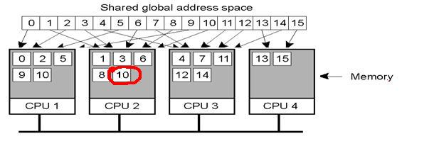
Release Consistency
在DSM的应用：进程A将acq()请求发送给同步管理者，要求在一特殊锁上执行acq()访问：无竞争时请求获准， 获取访问完成。A对共享数据在本地进行读写，不必同步更新副本。当执行rel()时，同步更新副本完成后，同步管理者被告知可以执行释放了。
Notes:
逻辑共享内存
和互斥的区别

Slide 32

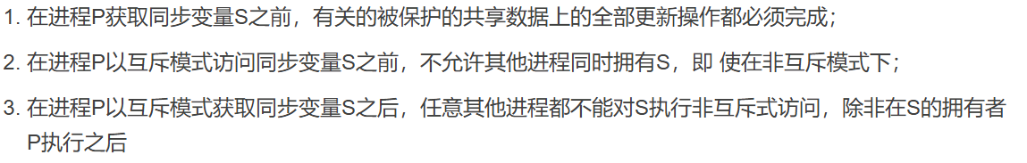
Entry Consistency (7.2.7)
Conditions:
An acquire access of a synchronization variable is not allowed to perform with respect to a process until all updates to the guarded shared data have been performed with respect to that process.
Before an exclusive mode access to a synchronization variable by a process is allowed to perform with respect to that process, no other process may hold the synchronization variable, not even in nonexclusive mode.
After an exclusive mode access to a synchronization variable has been performed, any other process's next nonexclusive mode access to that synchronization variable may not be performed until it has performed with respect to that variable's owner.
A valid event sequence for entry consistency.
1．当一进程的保护共享变量全部被更新以后，该进程才允许执行同步变量的获取访问；
2．在一进程以互斥模式访问该进程的同步变量之前，不允许其它进程持有此同步变量 ；
3．在结束互斥模式下对一个同步变量的访问后，任意其它进程必须与该变量的拥有者核查，才能试图以非互斥模式访问该同步变量。
Notes:
每个data item一个同步变量；允许多个临界区并行执行；
读-非互斥模式访问：
写-互斥模式访问：
1．当一进程的保护共享变量全部被更新以后，该进程才允许执行同步变量的获取访问；
2．在一进程以互斥模式访问该进程的同步变量之前，不允许其它进程持有此同步变量 ；
3．在结束互斥模式下对一个同步变量的访问后，任意其它进程必须与该变量的拥有者核查，才能试图以非互斥模式访问该同步变量。

Slide 33
Summary of Consistency Models
Consistency | Description
Strict | Absolute time ordering of all shared accesses matters.
Linearizability | All processes must see all shared accesses in the same order. Accesses are furthermore ordered according to a (nonunique) global timestamp
Sequential | All processes see all shared accesses in the same order. Accesses are not ordered in time
Causal | All processes see causally-related shared accesses in the same order.
FIFO | All processes see writes from each other in the order they were used. Writes from different processes may not always be seen in that order
 | (a)
Consistency | Description
Weak | Shared data can be counted on to be consistent only after a synchronization is done
Release | Shared data are made consistent when a critical region is exited
Entry | Shared data pertaining to a critical region are made consistent when a critical region is entered.
 | (b)
Consistency models not using synchronization operations.
Models with synchronization operations.
Notes:
同步变量：自己控制
透明性

Slide 34
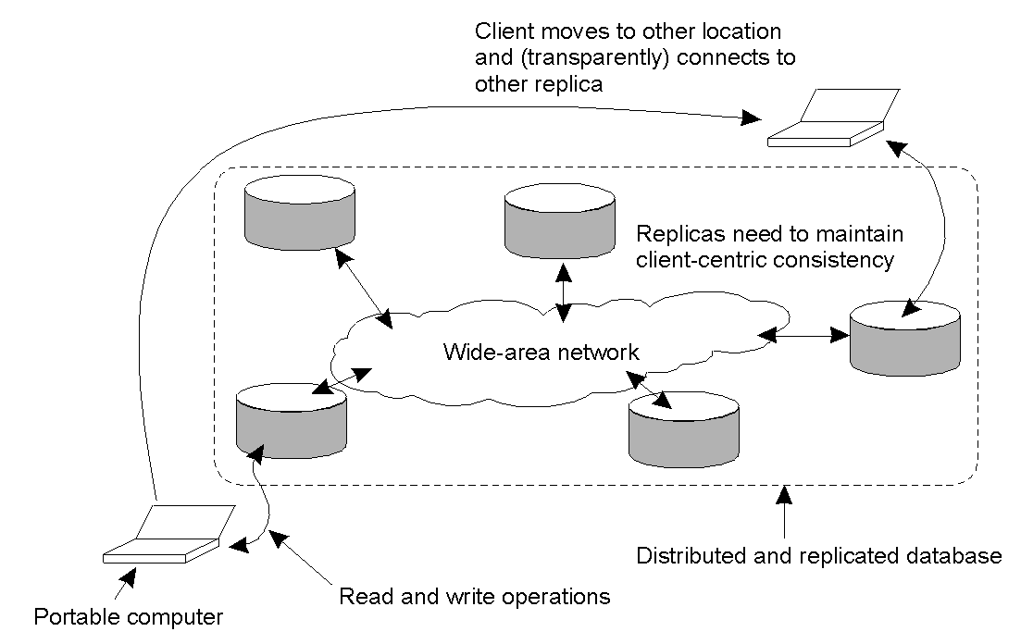
Client-Centric Consistency Models(7.3)
Client-centric consistency provides guarantees for a single client concerning the consistency of accesses to a data store by that client. No guarantees are given concerning concurrent accesses by different clients(No simultaneous updates)
The principle of a mobile user accessing different replicas of a distributed database.
Notes:
之前：面向数据存储的系统级一致性视角，原因：多个用户同时更新
应用场景：移动用户，不同备份

Slide 35
Eventual Consistency (7.3.1)
There are many cases of (large-scale) distributed and replicated databases that tolerate a relatively high degree of inconsistency. They have in common that if no updates take place for a long time, all replicas will gradually become consistent.---eventual consistency.
For example, DNS, WWW, etc.
Notes:
只有少数进程允许更新，且更新频率很低，传染协议
DNS服务器，www网页，

Slide 36
Monotonic-Read Consistency(7.3.2)
Condition:
If a process reads the value of a data item x, any successive read operation on x by that process will always return that same value or a more recent value.
(to guarantee that if a process has seen a value of x at time t, it will never see an older version of x at a later time).

Slide 37

Monotonic Reads
The read operations performed by a single process P at two different local copies of the same data store.
A monotonic-read consistent data store;
A data store that does not provide monotonic reads;
（WS(x_{i}[t])表示在时刻t，本地副本L_{i}上的一系列write操作的结果，t可以省略）
比如：阅读
Notes:
*
x：1副本，2副本；WS为针对x某一副本的写操作：
两个R为同一个进程读
两个WS为不同进程写

Slide 38

Monotonic-Write Consistence(7.3.3)
Condition: A write operation by a process on a data item x is completed before any successive write operation on x by the same process.
The write operations performed by a single process P at two different local copies of the same data store
a)A monotonic-write consistent data store.
b)A data store that does not provide monotonic-write consistency (missing W(x₁)).
举例：文档编辑
Notes:
扩散；
两个W为同一个进程写入；

Slide 39

Read-Your-Writes Consistency(7.3.4)
Condition: The effect of a write operation by a process on a data item x will always be seen by a successive read operation on x by the same process.
a)A data store that provides read-your-writes consistency.
b)A data store that does not(W(x₁) not been propagated to L₂).
应用举例：银行转账、售票系统等

Slide 40

Writes-Follow-Reads Consistency(7.3.5)
Condition: A write operation by a process on a data item x following a previous read operation on x by the same process, is guaranteed to take place on the same or a more recent value of that was read.(In other words, any successive write operation by a process on a data item x will be performed on a copy of x that is up to date with the value most recently read by that process )
A writes-follow-reads consistent data store
A data store that does not provide writes-follow-reads consistency
实例：Usenet或NewsGroup——新闻组，不同的用户通过一些软件可连接到新闻服务器上，阅读其他人的消息并可以参与讨论。
Notes:
R（x1）和WS（x1；x2）都由同一个进程完成；
*

Slide 41
Implementation(7.3.6)
A native implementation:
Each write operation is assigned a globally unique identifier by the server that accepts the operation for the first time(initiated by server).
For each client, we keep track of two sets of write identifiers.
The read set ={ the write identifiers relevant for the read operations performed by a client}. 该客户端读之前的写操作集合。
For example: Pid-read-set={wid1, wid2,…… widn}
The write set ={ the identifiers of the writes performed by the client}.该客户端写操作的集合

Slide 42
Implementation(7.3.6)
monotonic-read consistency: When a client performs a read operation at a server, that server is handed the client’s read set to check whether all the identified writes have taken place locally.
If not:
1) it contacts the other servers to ensure that it is brought up to date before carrying out the read operation. or
2) the read operation is forwarded to a server where the write operations that already taken place.
After the read operation is performed, the write operations that have taken place at the selected server and which are relevant for the read operation, are added to the client’s read set.
Read-set
Read
Read
Client A
Notes:
本次读的值和上次读的值至少一样，或者比上次值新；
Client开始读操作，读操作被发送到就近的一个副本上，为了保证单调读，

Slide 43
Implementation(7.3.6)
monotonic-write consistency: whenever a client initiate a new write operation at a server, it contacts the other servers to ensure that it is brought up to date before carrying out the write operation. or the write set is forwarded to a server where the write operations that already taken place. It then ensures that the identified write operations are performed first and in the correct order.
Write-set
After performing the new operation, that operation’s write identifier is added to the write set.
Write
Write
Client A
Notes:
Client开始写操作；写操作被发送到就近的一个副本上，为了保证单调写，

Slide 44
Implementation(7.3.6)
read-your-writes consistency: Requiring that the server where the read operation is performed has seen all the write operations in the client’s write set.
1) The writes can simply be fetched from other servers before the read operation is performed.
2) The client-side software can search for a server where the identified write operations in the client’s write set have already been performed.
Write-set
Read
Write
Client A
Notes:
对于同一个进程来说，上次写产生的影响能够被本次读看见
现在进程读，读操作被发送到就近的一个副本上，为了保证单调XXX，

Slide 45
Implementation(7.3.6)
writes-follow-reads consistency:
bringing the selected server up to date with the write operations in the client’s read set, and then later adding the identifier of the write operation to the write set, along with the identifiers in the read set.
Read-set
Write
Read
Client A
Notes:
现在进程写入，写操作被发送到就近的一个副本上，为了保证单调XXX，

Slide 46
DISTRIBUTION PROTOCOLS(7.4)
Discussing the different ways of propagating (distributing updates to replicas).
Deciding where, when, and by whom copies of the data store are to be placed.
边缘计算和CDN（内容分发网）的主要方法；
Notes:
通用方法，在此基础上-共识协议

Slide 47
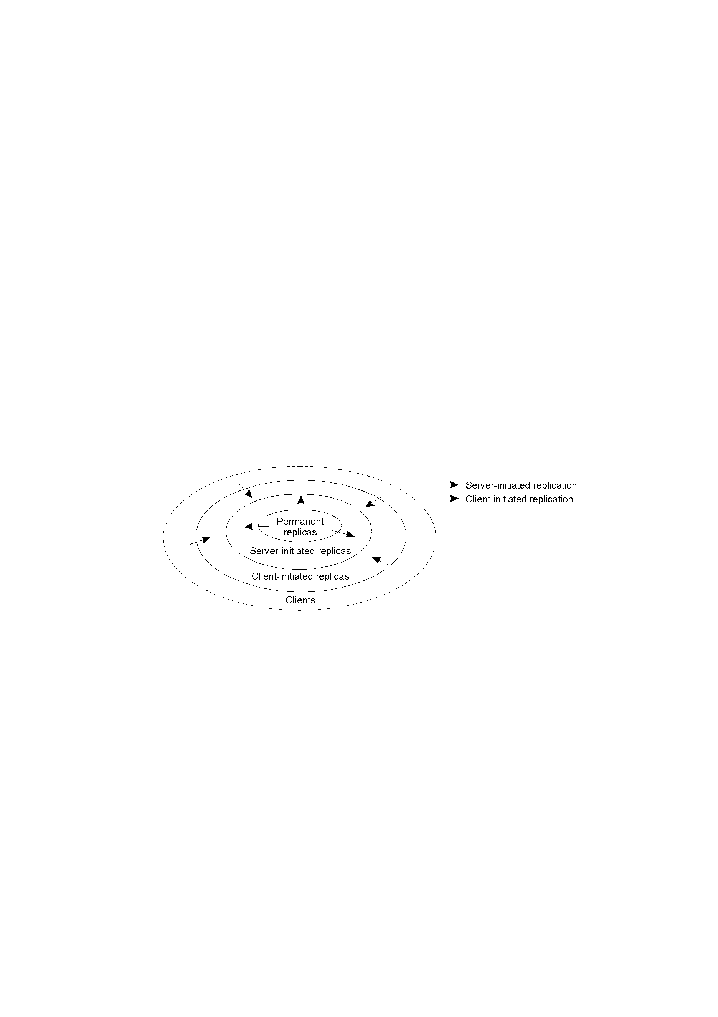
Replica Placement(7.4.1)
The initial set of replicas that constitute a distributed data store
The logical organization of different kinds of copies of a data store into three concentric rings.

Slide 48
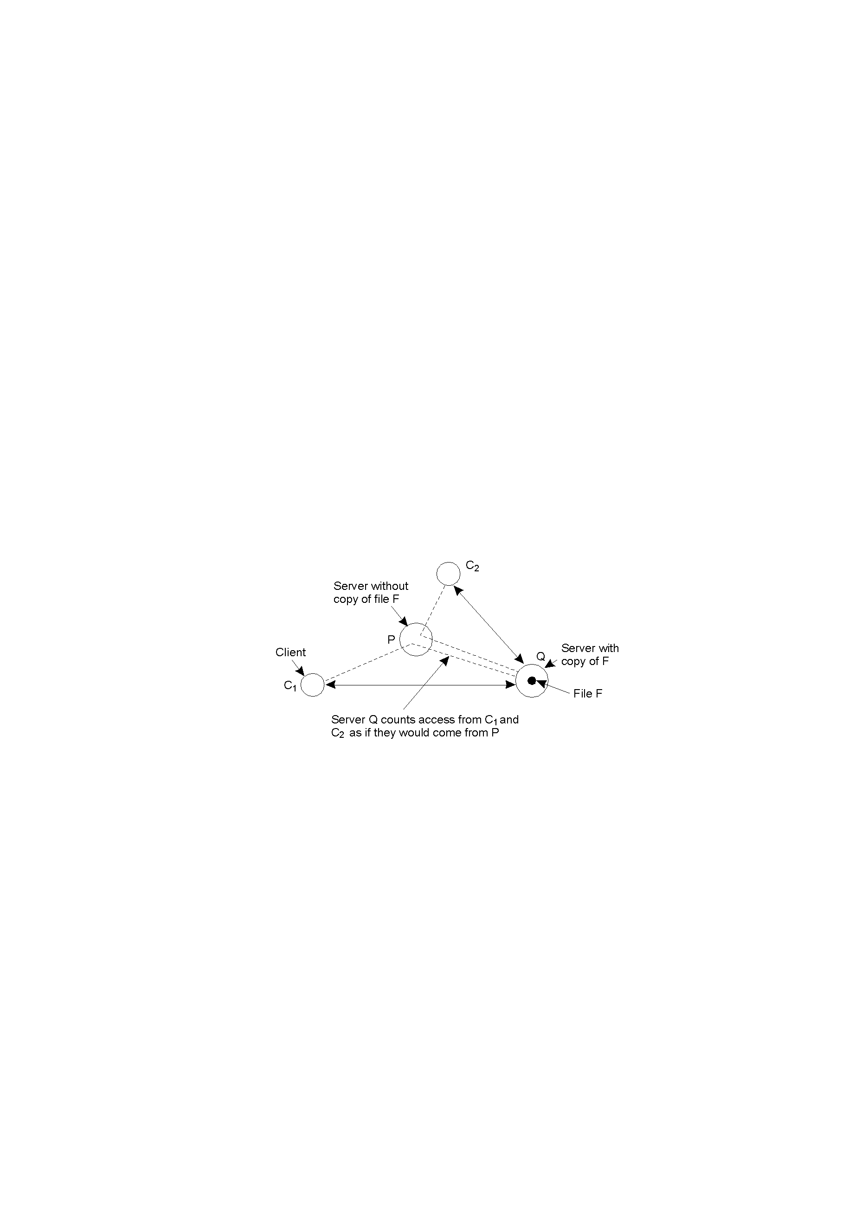
Server-Initiated Replicas
Knows as push caches/push mode：
to reduce the load on a server；
to be migrated , or replicated to server placed in the proximity of clients that issue many requests for those files；
Each server keeps track of access counts per file, and where access requests come from.
Counting access requests from different clients.
Notes:
为每一个文件维持一个计数器，及请求从哪里来

Slide 49
Server-Initiated Replicas
cnt_{Q}(P,F)-all access count for F at Q from C₁ and C₂ (C₁ and C₂ share the same closest server P),访问计数.
del(S,F)-deletion threshold
rep(S,F)-replication threshold
If cnt(S,F) < del(S,F) then remove F from S;
If cnt(S,F) > rep(S,F) then replicate F at S;
If del(S,F) < cnt(S,F) and cnt(S,F)< rep(S,F) then only to be migrated.
Notes:
*
何时备份一个文件；
Rep：S对每个服务器记录收到访问文件F的请求数；
Rep：S记录的收到访问文件F的请求数；

Slide 50
Client-Initiated Replicas
Known as client caches/pull mode.
Creating a cache at the client when needed and managing the cache is left entirely to that client.
举例：浏览器通常都自动缓存访问过的页面；
Notes:
Cache hit；
Cache更新；

Slide 51
Update Propagation(7.4.2)
Three propagations:
1. Propagate only a notification of an update
(known as invalidation protocols)
2. Transfer data from one copy to another.
3. Propagate the update operation to other copies.
Ensuring relevant consistency according to need
举例：网页的版本号、网页数据本身、以及对数据的更新操作
Notes:
当某一个副本被更新后，更新如何传播至其他副本：三种传播方式；

Slide 52
Pull versus Push Protocols
Issue | Push-based | Pull-based
State of server | List of client replicas and caches | None
Messages sent | Update (and possibly fetch update later) | Poll and update
Response time at client | Immediate (or fetch-update time) | Fetch-update time
If invalidation protocol
A comparison between push-based and pull-based protocols in the case of multiple client, single server systems.
Notes:
*传播方式
Push：永久-server发起-用户cache；
一致性强；
Pull：client发起的更新；主要发生在client cache端

Slide 53
Epidemic Protocols
Implement eventual-consistent based on epidemics.
a server P picks another server Q at random, and subsequently exchanges updates with Q.
Three approaches:
1. P only pushes its own updates to Q
2. P only pulls in new updates from Q
3. P and Q send updates to each other(pull-pull)

Slide 54
CONSISTENCY PROTOCOLS(7.5)
Implement a specific consistency model(sequential, weak consistency, and atomic transaction ).
“Global sequence”
7.5.1 Primary-based Protocols
Notes:
是否有主副本：所有写操作都要在主副本上执行
没有：写操作可以在任意副本上执行

Slide 55
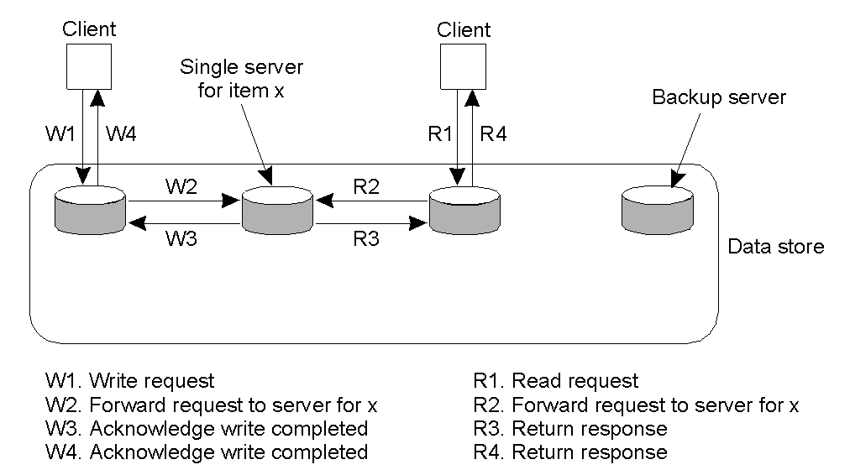
Remote-Write Protocols (1)
Primary-based remote-write protocol with a fixed server to which all read and write operations are forwarded(主副本固定).
Blocking or nonblocking
Notes:
读写都在一个远程服务器上，没有备份，client-server model，顺序一致性

Slide 56
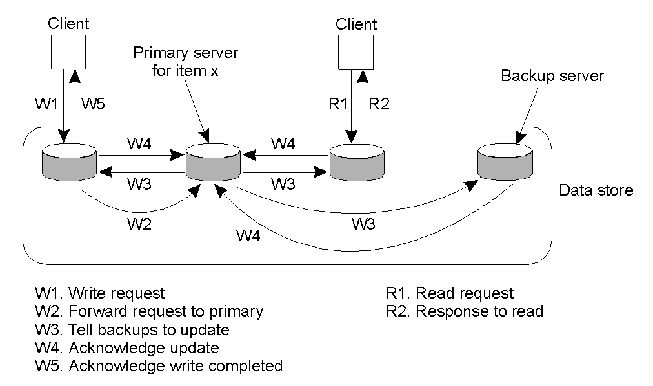
Remote-Write Protocols (2)
The principle of primary-backup protocol(带复制的主副本).
Notes:
带复制的主副本；
实现顺序一致性：主副本收到所有写请求，可排序，所有副本看到写一致性

Slide 57
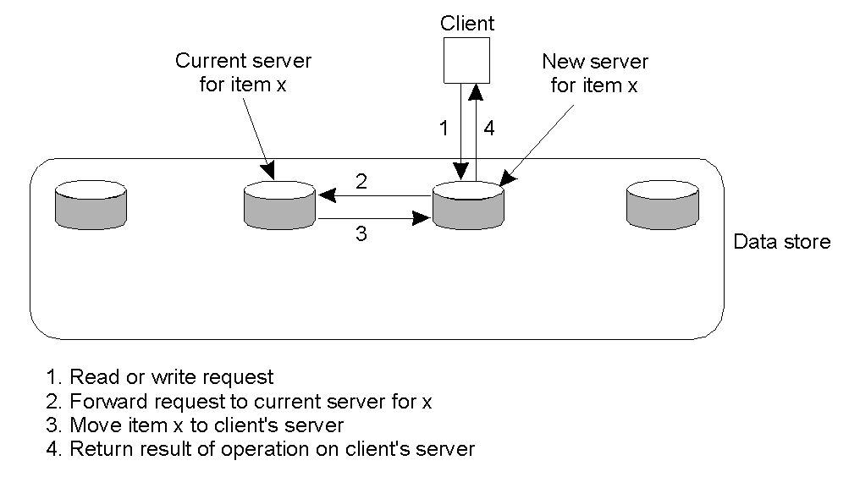
Local-Write Protocols (1)
Primary-based local-write protocol in which a single copy is migrated between processes(可移动的主副本).
Notes:
可移动的主副本，顺序一致性；只有一个副本；
主副本在多个服务器之间顺序移动；

Slide 58
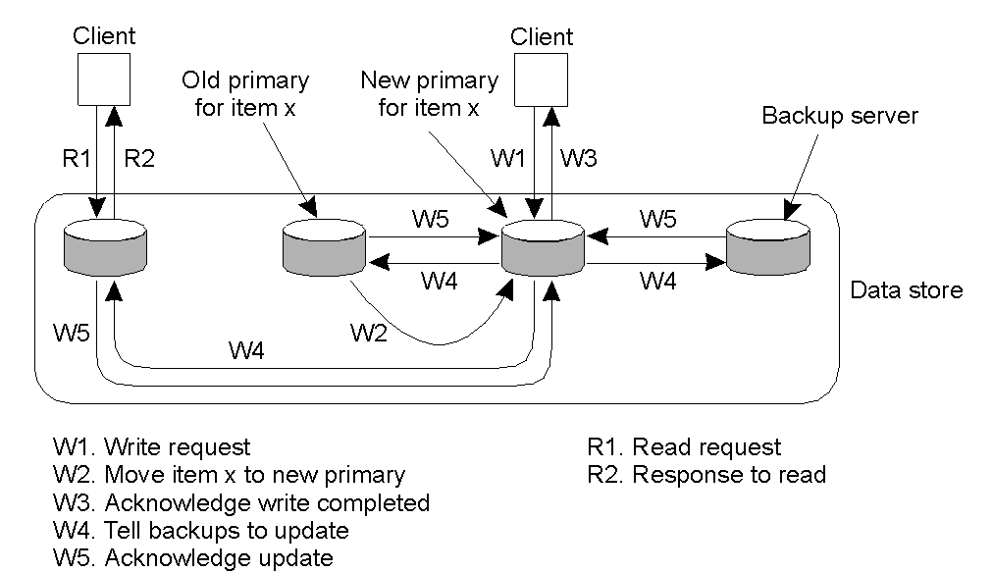
Local-Write Protocols (2)
Primary-backup protocol in which the primary migrates to the process wanting to perform an update (带复制的可移动主副本).

Slide 59
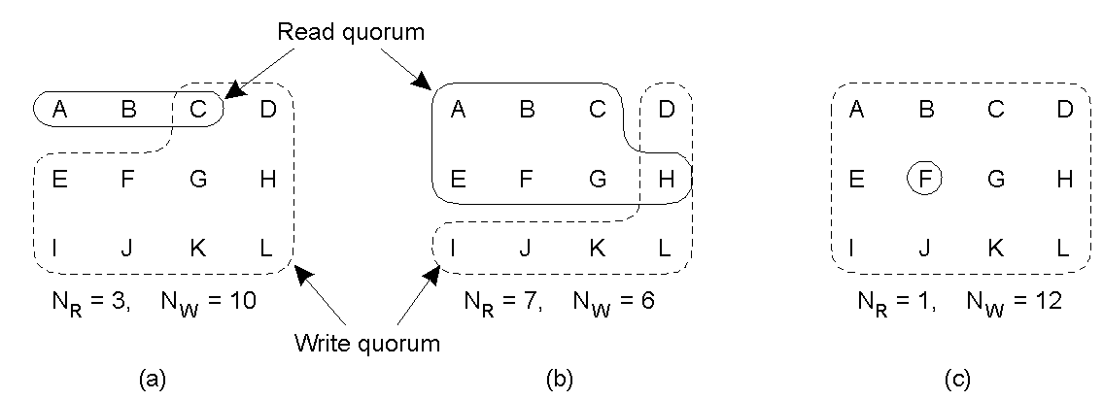
Quorum-Based Protocols
Two constraints(for N replicas): 1. N_{R} + N_{W} > N; 2. N_{W} > N/2
Three examples of the voting algorithm:
(a) A correct choice of read and write set;
(b) A choice that may lead to write-write conflicts;
(c) A correct choice, known as ROWA (read one, write all);
Notes:
顺序一致性
每一个数据有一个版本号，每更新一次版本号+1
每个服务器都有自己的副本；
1.读写冲突（排序）；2.写写冲突（排序）；
（a）最近一次的写投票集合为C到L，无论那三个节点选为读投票集合，总能找到最新版本
（b）写写冲突，两个写同时发生了，
（c) 设计性能balance：读一次，写全部；

Slide 60
背景: Paxos是古希腊一个小岛,其法令通过议会表决形成，议员和信使都是兼职且不一定在会议厅，议员通过信使传递消息,并且信使可能重复投递消息,也可能一去不复返。协议: 保证法令能够正确产生且不会出现冲突！
Paxos算法
Leslie Lamport1998在ACM TCS上发表了paxos的论文“The Part-Time Parliament”，由于晦涩难懂，2001年又发表了“Paxos Made Simple”；
Google使用算法后其声名大噪，Google Chubby 的作者Mike Burrows：There is only one consensus protocol, and that‘s Paxos”-all other approaches are just broken versions of Paxos. （OSDI 2006）

Slide 61
Introduction
Lock is the easiest way to manage concurrency
Mutex and semaphore.
Read and write locks in 2PL for transaction.
In distributed system:
No master for issuing locks.
Failures.
Problem: How to reach consensus/data consistency in distributed system that can tolerate non-malicious failures?
在分布式系统中有一组Process，它们需要确定一个Value。每个Process都提出了一个Value，共识(consensus)是指只能有一个Value被选中且作为终的值，并且当这个值被确定后，所有Processes都要被通知到.

Slide 62
Requirements
Safety
Only a value that has been proposed may be chosen.只有提案才能被选定；
Only a single value is chosen.只能有一个值被选定;
A node never learns that a value has been chosen unless it actually has been.除非那个提案被选中，否则，某个节点不会知道有提案被选中。
Liveness
Some proposed value is eventually chosen.保证最终有一个提案会被选定;
If a value has been chosen, a node can eventually learn the value.当提案被选定后，进程最终也能获取到被选定的提案。

Slide 63
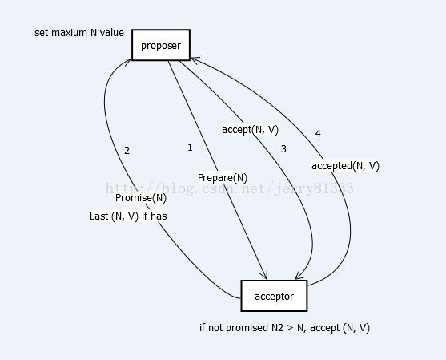
Paxos‘s notation and algorithm
Classes of agents A node can act as more than one clients (usually 3):
Proposers；
Acceptors；
Learners；
3.收到大多数的y回答，发送编号n的值v
1.向多数接收者发送编号为n预请求
算法思想：
2.接受者只响应目前编号最大的提案请求者.

Slide 64
Paxos algorithm
Phase 1 (prepare):
A proposer selects a proposal number n and sends a prepare request with number n to majority of acceptors.向大多数接收者发送编号为n预请求；
If an acceptor receives a prepare request with number n greater than that of any prepare request it saw, it responses YES to that request with a promise not to accept any more proposals numbered less than n and include the highest-numbered proposal (if any) that it has accepted.接受者只响应目前编号最大的提案请求者.
Phase 2 (accept):
If the proposer receives a response YES to its prepare requests from a majority of acceptors, then it sends an accept request to each of those acceptors for a proposal numbered n with a values v which is the value of the highest-numbered proposal among the responses.收到大多数的y回答，发送编号n的值
If an acceptor receives an accept request for a proposal numbered n, it accepts the proposal unless it has already responded to a prepare request having a number greater than n.

Slide 65
Definition of chosen
A value is chosen at proposal number n iff majority of acceptor accept that value in phase 2 of the proposal number.
Paxos’s properties
P1: Any proposal number is unique.
P2: Any two set of acceptors have at least one acceptor in common.
P3: the value sent out in phase 2 is the value of the highest-numbered proposal of all the responses in phase 1.
Learning a chosen value
There are some options:
Each acceptor, whenever it accepts a proposal, informs all the learners. Acceptors informs a distinguished learner (usually the proposer) and let the distinguished learner broadcast the result.

Slide 66
Classic Paxos
情形1: Paxos without Proposer Competition
Prepare
set abc = 0
(1)
Response
abc = X
Response (1) && Promise

Slide 67
Classic Paxos
Accept
(1, set abc=0)
abc = X
Response (1) && Promise
Accept (1, set abc=0) && Promise

Slide 68
Classic Paxos
Accept
set abc=0 accpeted
Accepted
abc = 0
Accept (1, set abc=0) && Promise

Slide 69
Classic Paxos
情形2: Paxos with Proposer Competition
Prepare
set abc=1
set abc=0
(2)
(1)
abc = X

Slide 70
Classic Paxos
Prepare
Response
Response
abc = X
Response (2) && Promise
Response (1) && Promise

Slide 71
Classic Paxos
Prepare/Accept
Response
(1, set abc =0)
Response
(1, set abc=0)
abc = X
Response (1) && Promise
Response (2) && Promise
Accept (1, set abc=0) && Promise

Slide 72
Classic Paxos
Accept
(2, set abc =0)
(1, set abc=0)
abc = 0
abc = X
Response (2) && Promise
Accept (2, set abc =0) && Promise
Accept (1, set abc=0) && Promise

Slide 73
Tunable knobs(可调旋钮)
Acceptors have many options to response:
Prepare request: No/Yes
Accept request: No/Yes if it didn’t promise not to do so
Back off time after abandon a proposal: exponential back-off/pre-assigned values
Should we wait for nodes to online in each phase?
Applications
Chubby lock service.
Petal: Distributed virtual disks.
Frangipani: A scalable distributed file system.

Slide 74
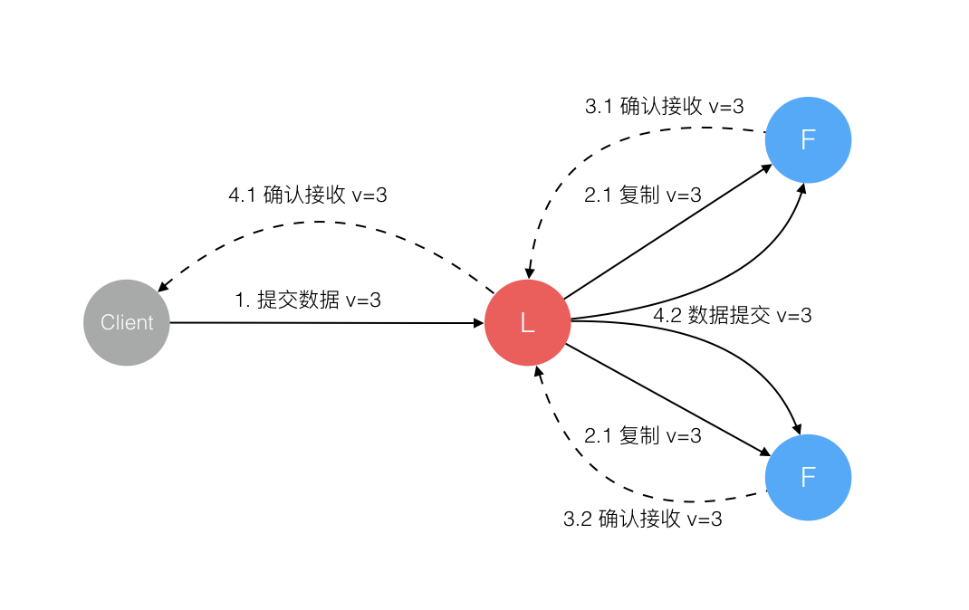
Raft algorithm：In Search of an Understandable Consensus Algorithm(Extended Version)，Diego Ongaro and John Ousterhout，Stanford University，May 20, 2014.
Raft is a consensus algorithm for managing a replicated log. It produces a result equivalent to (multi-)Paxos, and it is as efficient as Paxos, but its structure is different from Paxos；
Raft 协议强依赖 Leader 节点的可用性来确保集群数据的一致性。类似于事务的两阶段提交协议完成数据的一致性。

Slide 75
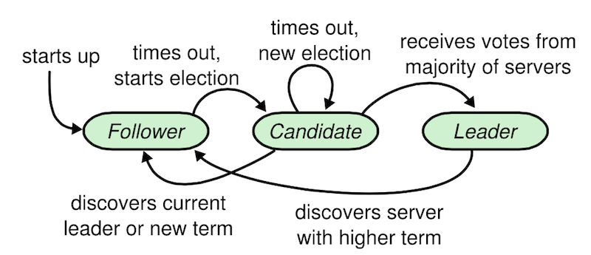
Raft algorithm
Raft 中有三类角色：
Leader
Follower
Candidate
当Leader出现故障时选举一个从Candidate节点中选取一个（算法：Bully算法和环算法）。

Slide 76
Raft algorithm
接下来只要解决协议中的故障问题即可：
1. 数据到达 Leader 节点前；
2. 数据到达 Leader 节点，但未复制到 Follower 节点；
3. 数据到达 Leader 节点，成功复制到 Follower 所有节点，但还未向 Leader 响应接收；
4. 数据到达 Leader 节点，成功复制到 Follower 部分节点，但还未向 Leader 响应接收；
5. 数据到达 Leader 节点，成功复制到 Follower 所有或多数节点，数据在 Leader 处于已提交状态，但在 Follower 处于未提交状态；

Slide 77
Orca(Example)
Orca is a programming system that allows processes of different machines to have controlled access to a distributed shared memory consists of protected objects.
The Orca system consists of the Orca language (object-based language), compiler, and runtime system that actually manages the shared objects during execution.

Slide 78
Orca(Example)
OBJECT IMPLEMENTATION stack; top: integer; # variable indicating the top stack: ARRAY[integer 0..N-1] OF integer # storage for the stack
OPERATION push (item: integer) # function returning nothing BEGIN GUARD top < N DO stack [top] := item; # push item onto the stack top := top + 1; # increment the stack pointer OD; END;
OPERATION pop():integer; # function returning an integer BEGIN GUARD top > 0 DO # suspend if the stack is empty top := top – 1; # decrement the stack pointer RETURN stack [top]; # return the top item OD; END; BEGIN top := 0; # initialization END;
A simplified stack object in Orca, with internal data and two operations (Orca object-based language).

Slide 79
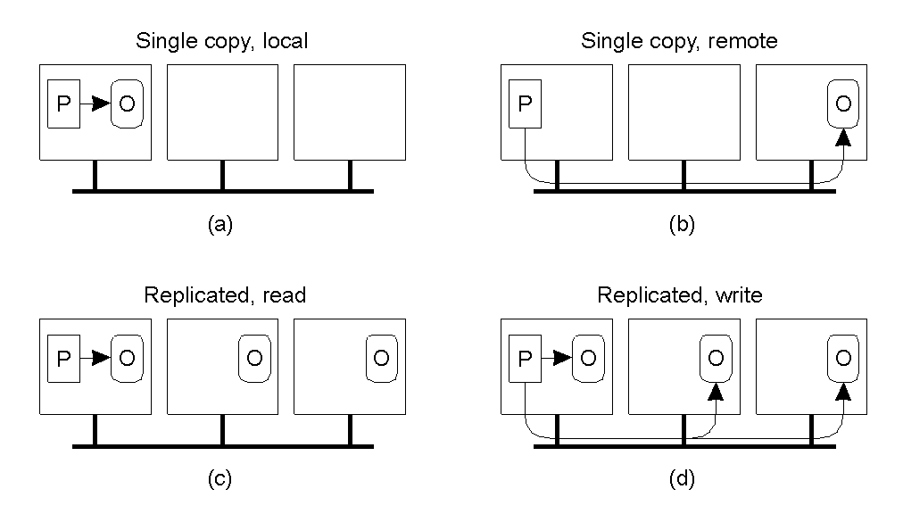
Management of Shared Objects in Orca
RPC
可靠的广播
Four cases of a process P performing an operation on an object O in Orca.

